Slide 1
Accessing Global Opportunities
Mkpe kekung
Seminar Presentation to ACENPEE Students, ABU, Zaria

Slide 2
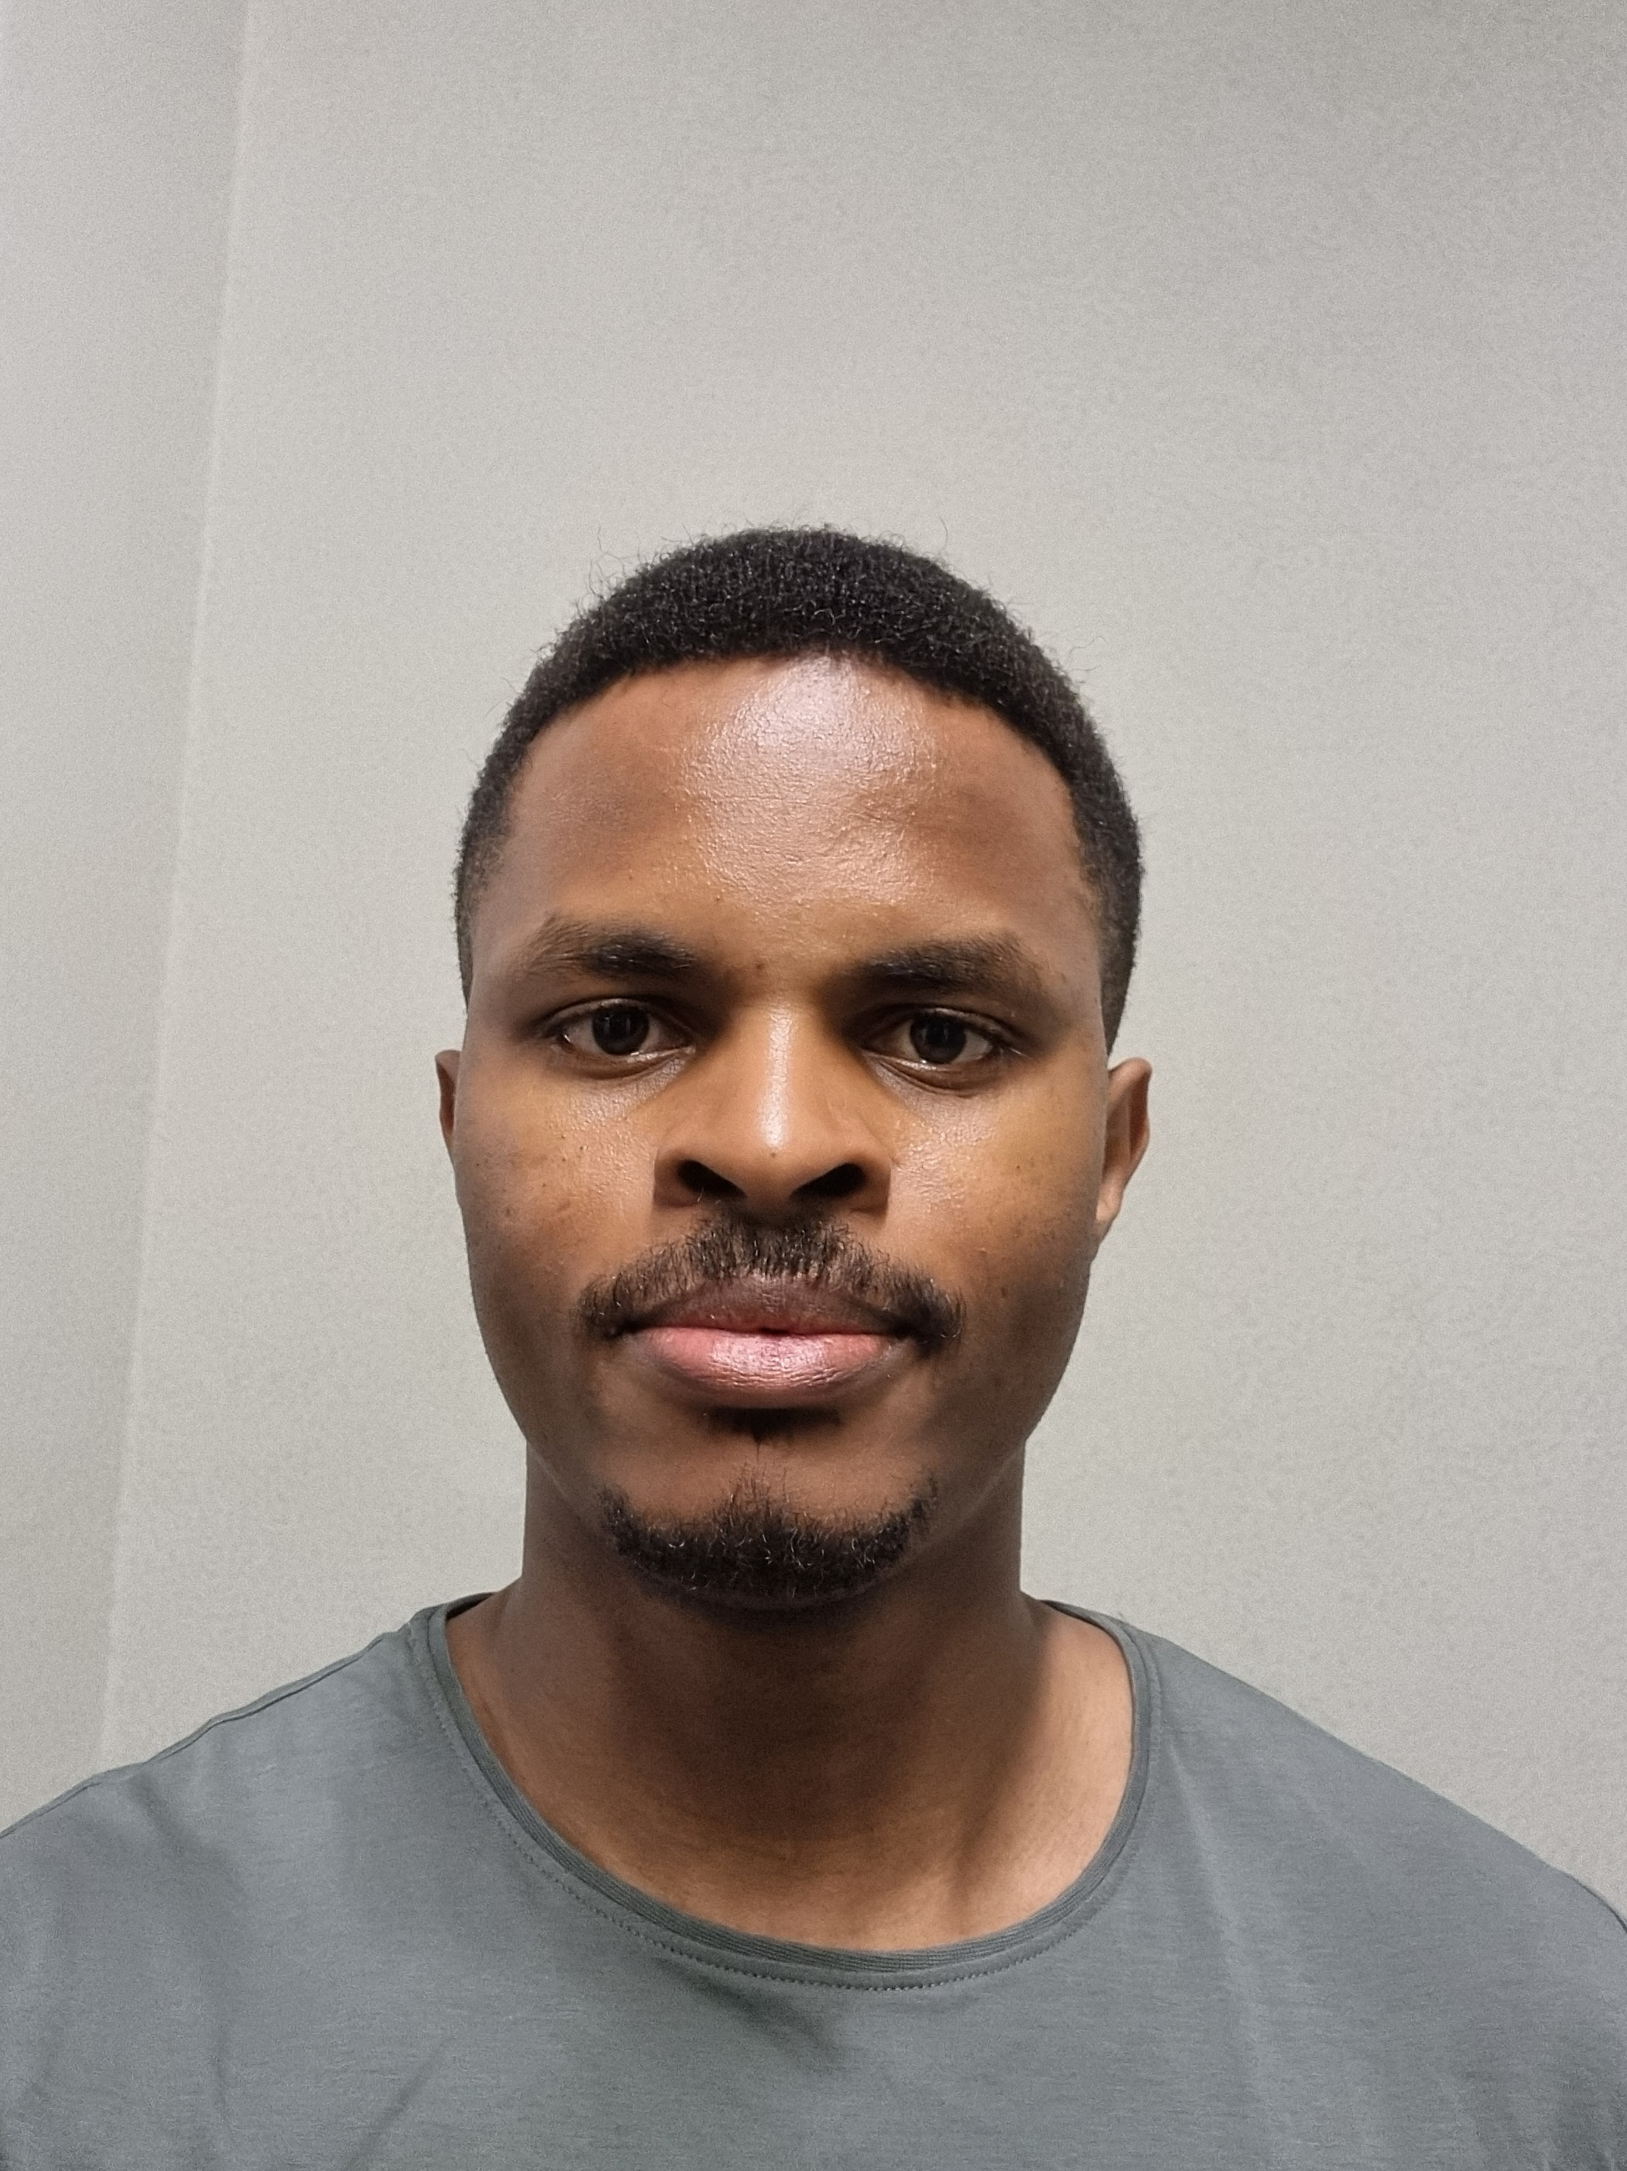
Mkpe Kekung
(MSc, Mechanical Eng)
B.Eng., Mechanical Engineering
(2013-2018)
NYSC, Incomplete MSc
(Energy Studies)
(2019-2022)
Ahmadu Bello University, Zaria, Nigeria
M.Sc. Tribology of Surfaces and Interfaces (2022-2024)
Erasmus Mundus Joint Masters, UK, Slovenia, Sweden
PhD – Mechanical Engineering
(Starting August 2024)
Iowa State University, USA
Federal University of Agriculture Makurdi, Nigeria

Slide 3
My Journey – University of Agriculture Makurdi
Undergraduate project
Internship at Kaduna Refinery

Slide 4
My Journey – Ahmadu Bello University
Energy Studies
Thesis: Pyrolysis of Palm Empty Fruit bunches (EFB) for Bio-oil Production
Effects of additive kaolin

Slide 5
InVEST collaboration, Canada
Support and enabling facilities
Mentorship and guidance
Funded internship – Bon Affaires Industry, Kaduna
Engineering and entrepreneurial projects
Intercultural competences

Slide 6
Study in Canada Scholarship
$\text{\$}$12,700 CAD
TOPIC:
Pyrolysis of Palm Empty Fruit Bunches (EFB) for Bio-oil and Char Production

Slide 7
Publications

Slide 8
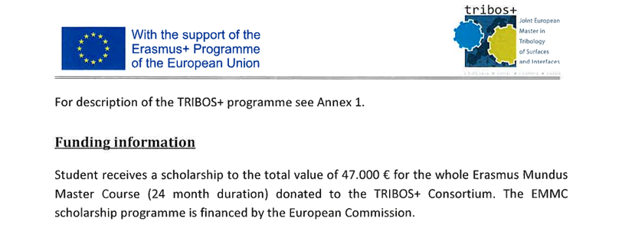
Erasmus Mundus Joint Masters
$$€47,000$$

Slide 9
TRIBOS Consortium

Slide 10
Erasmus Mundus Joint Masters
First Semester
Second Semester
Final year
United Kingdom
Slovenia
Sweden
Lubrication, Oilfield chemistry & Corrosion
Material Selection and failure analysis
Internship at JSI – Additive manufacturing of Nd2Fe14B PM
BIP on AI and Machine Learning – Germany
Thesis: Electric motor optimisation

Slide 11
Graduation

Slide 12
Applying for Scholarships

Slide 13
Accessible Scholarship Opportunities
1. Erasmus Mundus Scholarship
2. Chevening Scholarship
3. Commonwealth Scholarship
4. Japanese Government Scholarship (MEXT)
5. Global Korean Scholarship
6. MasterCard Scholarship
7. Russian Open doors scholarship
8. Banach Scholarship in Poland
9. Graduate assistantships in the US

Slide 14
Needed documents
International passport
University transcript
Certificate/Statement of result
Academic CV
Statement of Purpose (SOP)
Recommendation/reference letters
Proof of English language proficiency(optional in most cases) IELTS, TOEFL etc
Police character certificate (optional)
Proof of residency (optional)

Slide 15
Mindset for global opportunities
determination
Diligence
Resilience

Slide 16
Have the “I can do it” mindset

Slide 17
Do your due diligence

Slide 18
Be resilient
Talent is not enough.
What do you do when the going gets tough?
Don’t give up.

Slide 19
Where there is a will, there is a way

Slide 20
Benefits
Well catered for
Global recognition
Limitless opportunities
Rigorous academic work to develop you
Opportunity to travel
Networking

Slide 21
Trust the process
The PROCESS prepares you.

Slide 22
Thank you for listening!

